Slide 1
Principal Component Analysis
Course : COMP6065001 Artificial Intelligence
Effective Period : September 2023
Session 23

Slide 2
Learning Outcome
At the end of this session, students will be able to:
LO 4: Apply various learning algorithms to solve the problems

Slide 3
Outline
Covariance
Eigen Value and Vector
Curse of Dimensionality
PCA Algorithm
Exercise

Slide 4
Before We Start
Before we start Principal Component Analysis, we will review some mathematical concept in linear algebra.
Covariance Matrix
Eigen Vector and Eigen Value

Slide 5

COVARIANCE MATRIX
Example:
Covariance Matrix of the example:
$$\left[\begin{matrix}Var (W) & Cov (W,H) & Cov(W,A) \\ Cov(H,W) & Var(H) & Cov(H,A) \\ Cov(A,W) & Cov(A,H) & Var(A)\end{matrix}\right]$$
ID | Weight (W) | Height (H) | Age (A)
1 | 50 | 160 | 20
2 | 40 | 155 | 18
3 | 55 | 160 | 19

Slide 6

COVARIANCE MATRIX
Example:
Covariance Equation
$$Cov\left(W,H\right)= \frac{\sum{(w−\overline{w})(h−\overline{h})}}{n} \\ =\frac{\left(50−48.33\right)\left(160−158.33\right)+\left(40−48.33\right)\left(155−158.33\right)+\left(55−48.33\right)\left(160−158.33\right)}{3} \\ =\frac{2.7889+27.7389+11.1389}{3} \\ =13.8889$$
Notes : $\overline{w}$: mean of $w$
ID | Weight (W) | Height (H) | Age (A)
1 | 50 | 160 | 20
2 | 40 | 155 | 18
3 | 55 | 160 | 19

Slide 7
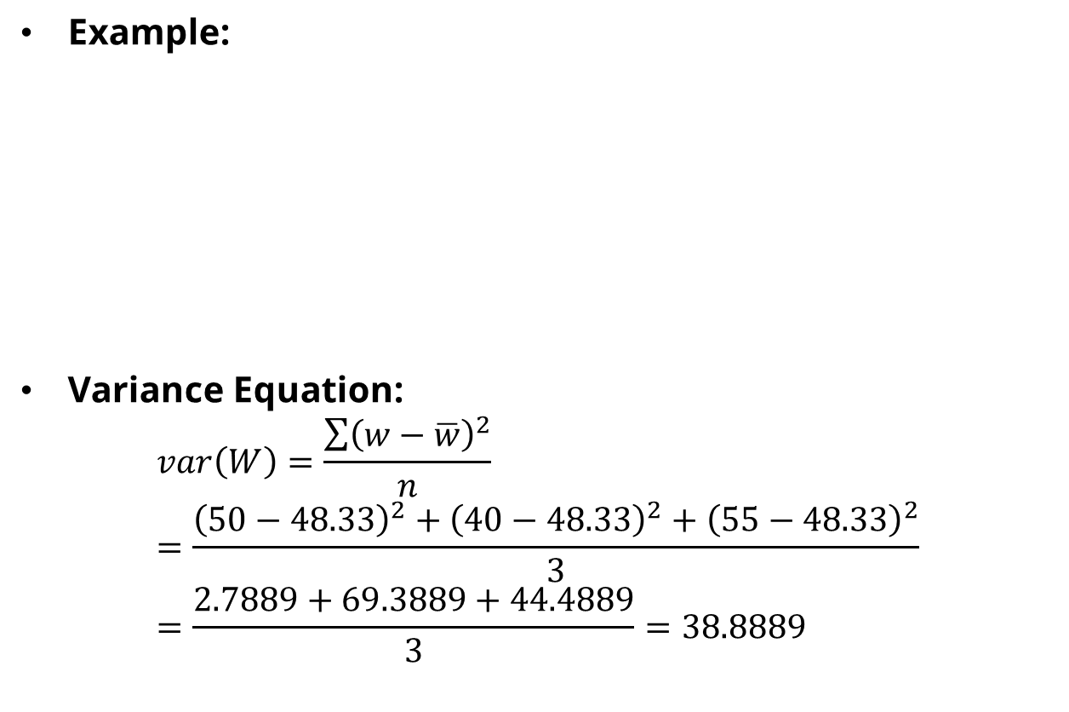
Covariance Matrix
Example:
Variance Equation:
$$var\left(W\right)=\frac{\sum{{\left(w−\overline{w}\right)}^{2}}}{n} \\ =\frac{{\left(50−48.33\right)}^{2}+{\left(40−48.33\right)}^{2}+{\left(55−48.33\right)}^{2}}{3} \\ =\frac{2.7889+69.3889+44.4889}{3}=38.8889$$
ID | Weight (W) | Height (H) | Age (A)
1 | 50 | 160 | 20
2 | 40 | 155 | 18
3 | 55 | 160 | 19

Slide 8

Covariance Matrix
Example:
Covariance Matrix
$$\left[\begin{matrix}38.8889 & 13.8889 & 3.333 \\ 13.8889 & 5.5556 & 1.6667 \\ 3.3333 & 1.6667 & 0.667\end{matrix}\right]$$
ID | Weight (W) | Height (H) | Age (A)
1 | 50 | 160 | 20
2 | 40 | 155 | 18
3 | 55 | 160 | 19

Slide 9
Covariance and Variance
Covariance is a measure of the extent to which corresponding elements from two sets of ordered data move in the same direction.
Variance is a measure of the variability or spread in a set of data.

Slide 10
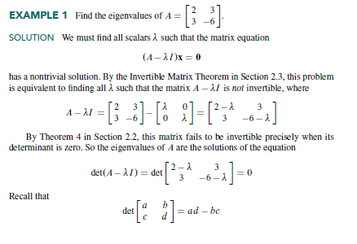
Eigen Value and Eigen Vector

Slide 11
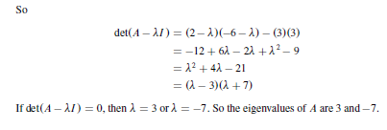
Eigen Value and Eigen Vector

Slide 12
Principal Component Analysis

Slide 13
Introduction
Assume, we have 100 features in our data. Without losing any information of the data. How do we process our data without all the features included?
There are many approach to handle the problem, one of them is dimensional reduction.
The simple way to dimensional reduction is using Sequential Floating Forward Selection (SFFS). or
Using linear transformation concept, from 100 dimension into fewer dimension using Principal Component Analysis (PCA) algorithm.
The Advantages of dimensional reduction are faster computation, lower storage usage and many more.

Slide 14
Curse of Dimensionality
What is Curse of Dimensionality?

Slide 15
Principal Component Analysis (PCA)
PCA is “a transformation that transfers the data to a new coordinate system such that the greatest variance by any projection of the data comes to lie on the first coordinate (first principal component ), the second greatest variance lies on the second coordinate ( second principal component ), and so

Slide 16
PCA Algorithm
Standardization all values on each variables
Find the Covariance Matrix
Find the eigen value and eigen vector from covariance matrix
Sort the eigen value from the largest to smallest to find the principal component
Create a new feature vector based on the chosen principal component

Slide 17
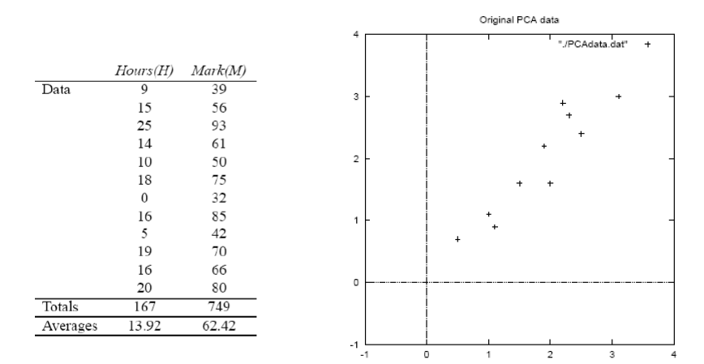
Example of PCA

Slide 18
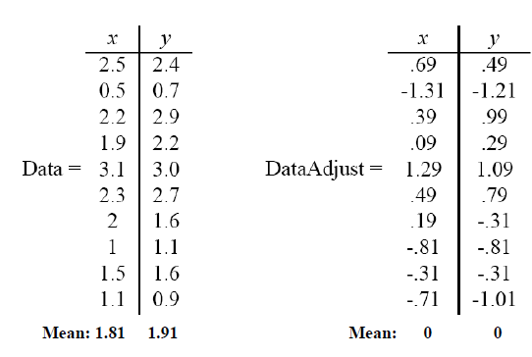

Step 1: Find the standardization
In this lesson, for the standardization we will use z-score.
$$zscore=\frac{raw score−mean}{standar deviation}$$

Slide 19
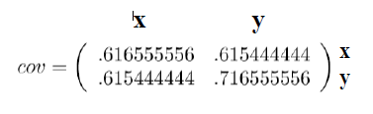
Step 2: Find the covariance Matrix

Slide 20
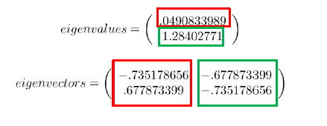
Step 3: Find the eigen value and eigen vector from covariance matrix

Slide 21
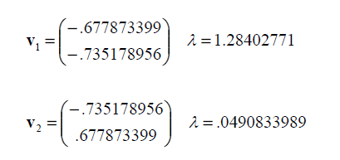
Step 4: Sorted the eigen vector and value

Slide 22

Step 5: Find the new vector
Remainder: In PCA the principal component [T] is the inverse of sorted eigen vector:

Slide 23
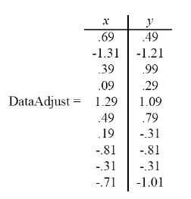

Step 5: Find the new vector
The new vector values from the first data:

Slide 24
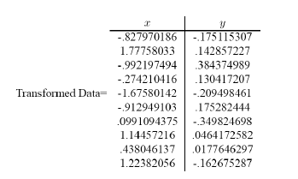
Step 5: Find the new vector
The result of new feature vector

Slide 25
Dimensional Reduction?
To reduce the dimension of data we need to do another thing.
In simple way, remove the eigen vector that has smallest eigen values.

Slide 26


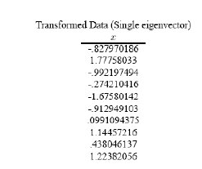
Step 5: Find the new vector

Slide 27
References
David Lay, Steven Lay and Judi McDonald. Linear Algebra and Its Application.2014. Pearson 5th Edition. ISBN: 9780321982384

